Slide 1
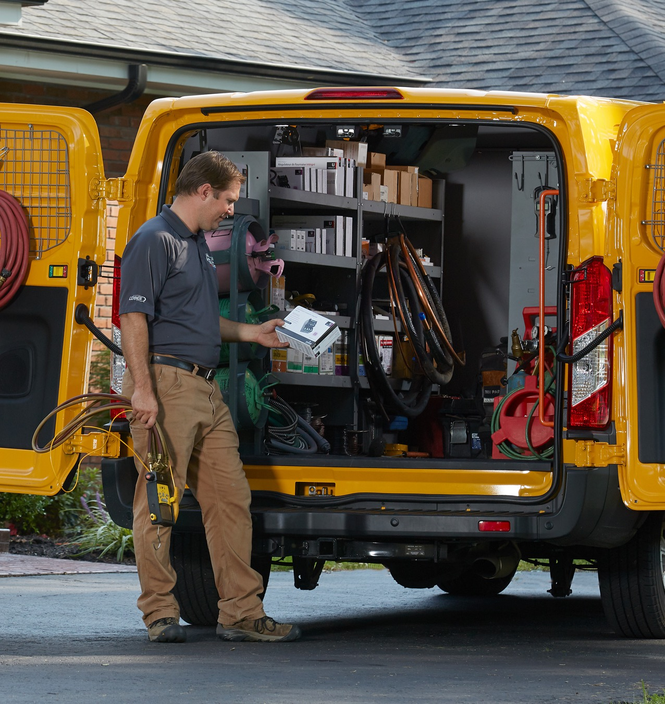
White-Rodgers
Universal Controls
Product Training

Slide 2
Benefits of Universal Controls

Slide 3
Cover more applications with fewer controls
With 100+ years of experience building OEM parts, White-Rodgers has the expertise to create universal controls that can seamlessly replace thousands of OEM items that match the fit, form, and function of the original controls.
We build parts designed for multiple OEM applications
Footprint
Mounting
Wiring
Setup

Slide 4
Replace More. Carry Less.
With rising operational costs it’s more important than ever to take any job from start to finish in one call.
Universal replacement parts increase profitability
Improve productivity
Save time searching for exact parts
Have the right part on the truck for the job
Decrease Costs
Reduce inventory
Eliminate extra trips or added shipping charges
Serve more customers
Finish the job in one trip
Complete more jobs in less time

Slide 5
What is the actual cost to roll a truck?
Questions
What is the average wage for an experienced tech? $35
What is the average 1-hour Service Charge? $135
What is the average service truck miles per year? 30K
Actual hourly cost to roll an empty truck. $95.57
Adjusted gross profit per billable hour. $39.43

Slide 6
True cost of not having the right part on the truck
Questions
How many trips per month does tech not have the right part? 10
What is the average time wasted running to the supply house? 1.5 hours
Approximate lost revenue every time you don’t have the right part: $307
Potential yearly lost revenue for one service truck could exceed: $36K

Slide 7
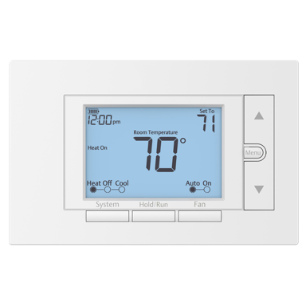
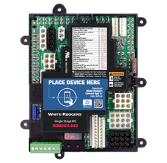
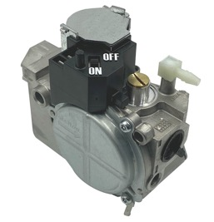
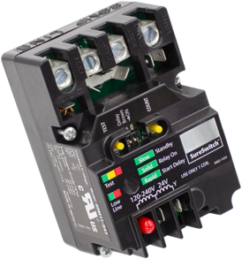
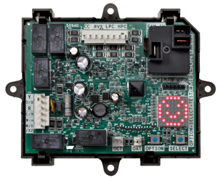
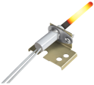
Universal Control Overview
Have the right part at the right time
Heating
Replace thousands of part numbers
Cooling / Heat Pumps
Replace most applications regardless of manufacturer
Thermostats
Replace most low voltage models
Ignitors & Flame Sensors
Integrated Furnace Controls
Ignition Modules
Electronic Fan Timer
Gas Valves
Contactors
Filter Driers
Thermostatics Expansion Valves
Defrost Control
Temperature Control
Touch screen
Wi-Fi compatible
Programmable/non-programmable
Various price points

Slide 8
Over Twice As Many Cross References As Resideo
Universal Electronic Controls
WHITE-RODGERS |  |  | RESIDEO / HONEYWELL
MODEL NUMBER | DESCRIPTION | X-REFS | PART NUMBER | DESCRIPTION | X-REFS
50M56X-843 | 1-Stage IFC PSC/ECMx 80V/120V | 550+ | S9200U 1000 | IFC PSC 120V | 204
21M51U-843 | 2-stage IFC PSC 80V/120V | 92 | — | — | —
21V51U-843 | 2-stage IFC Variable Speed 80V/120V | 59 | — | — | —
50E47U-843 | Hot Surface Ignition Module | 325+ | S8910U 3000 | Hot Surface Ignition Module | 107
50D50U-843 | All-Spark™ IP/DSI Module | 1020 | S8610U 3009 | IP Module | 457
50I56D-905 | Intelligent Valve Retrofit Kit | 53 | SV9501 M2528 & SV9502 H2522 | SmartValve™ | 18
50F06-843 | Electronic Fan Timer | 162 | ST9120U 1011 | Electronic Fan Timer | 49
21D64-44 | HotRod™ EX Ignitor | 278 | Q3200U 1004 | Glowfly Ignitor | 114
790-843A1 | Flame Sensor | 159 | — | — | —
47D01U-843 | Defrost Control | 438 | DB7110U 1000 | Defrost Control | 264
49M11-843 | SureSwitch™ Multivolt Contactor | 362 | — | — | —
— | — | — | Y8610U 6006 | Standing Pilot Retrofit | —
— | — | — | R7284U 1004 | Oil Primary | 70
TOTAL: 3,498+
CROSS REFERENCES
HONEYWELL/RESIDIO
TOTAL:
1,283+
CROSS REFERENCES
WHITE-RODGERS

Slide 9
Our commitment to you
Reliable product with over 80 years of industry experience
More cross references than the competition at comparable prices
Trusted by more OEMs than any other brand
Simple and fast installation through innovative technology and product features
Contractor tools and support to ensure success
photo
Reliable product with over 80 years of industry experience.
More cross references than the competition at comparable prices.
Trusted by more OEMs than any other brand.
Simple and fast installation through innovative technology and product features.
Contractor tools and support to ensure success.

Slide 10
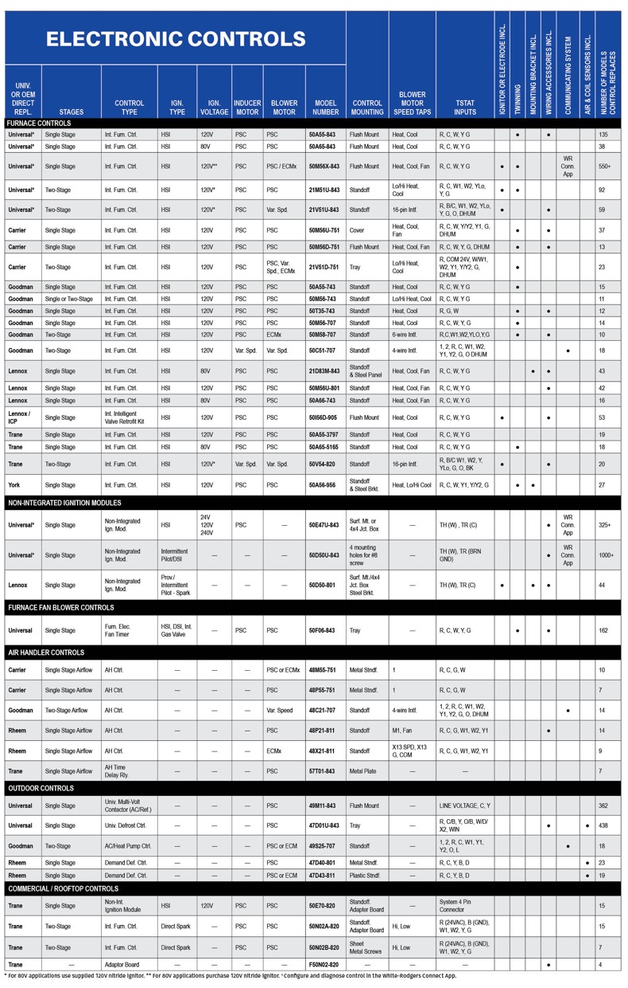
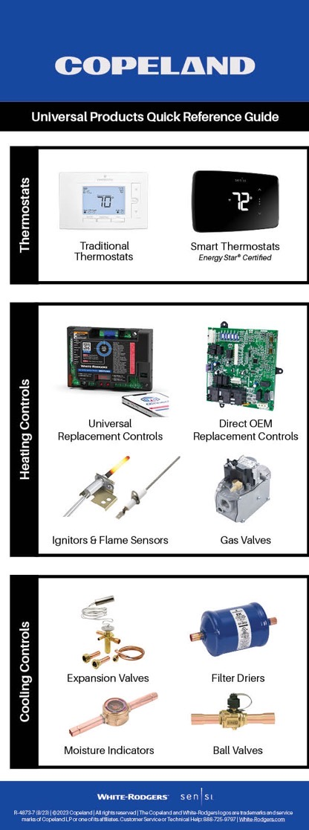
Quick Reference Guide
The visor card gives you a quick reference to top products with listed features.

Slide 11
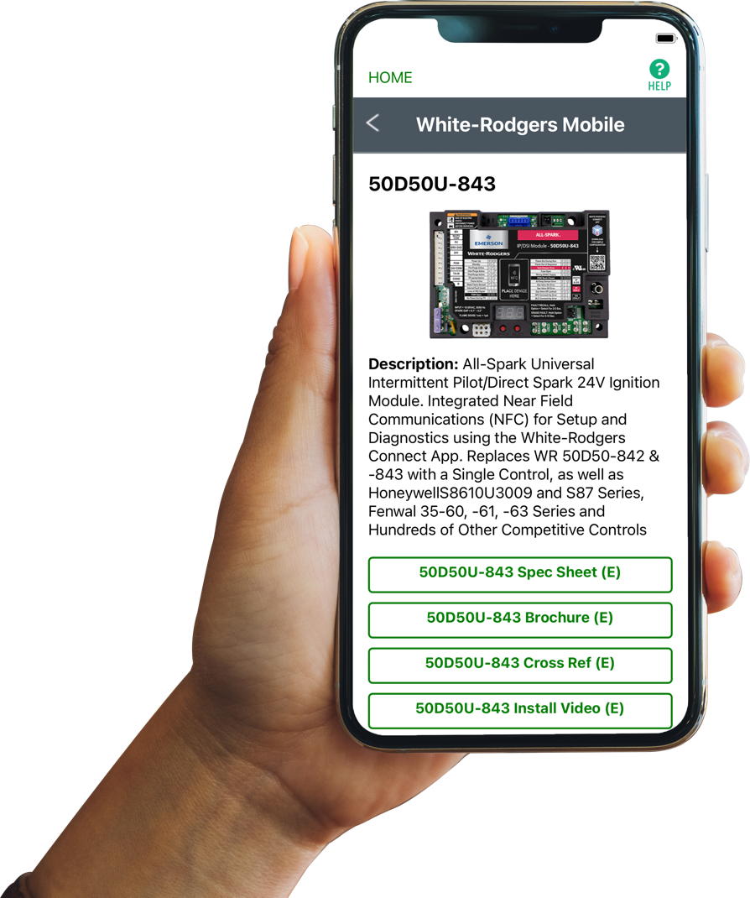
Comprehensive Cross Reference & Product Information
Find the right part while on the job.
Your on-the-go resource for:
Complete cross reference
Product information and spec sheets
Installation information and videos
Wiring diagrams
Select product by features
Priority technical support
WR Mobile App Search for “WR Mobile” in both Apple and Google Play Stores
Desktop Version Access the online version HERE
Search by OEM, Competitor and White-Rodgers part numbers.

Slide 12
Heating Controls

Slide 13
Universal Integrated Furnace Control
Simple configuration and diagnostics with White-Rodgers Connect
Single Stage Furnace Control
50M56X-843
Replaces over 550 part numbers ​​for both PSC & ECMx blower motors
Direct plug-in of OEM harnesses, no additional harnesses required​​
120v HotRod Ignitor included for upgrading 80v applications
Digital display provides alternate method to configure & diagnose
Detachable thermostat bus connector for easy wiring
Flame current readout on digital display or use of test pins​​

Slide 14
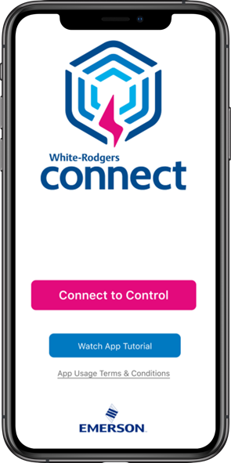
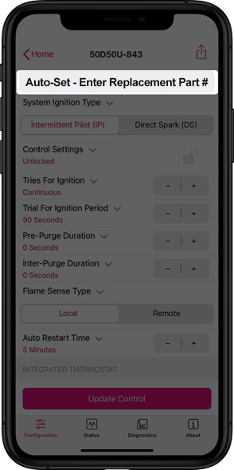
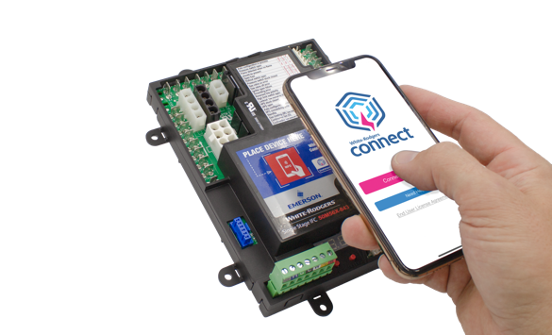
White-Rodgers Connect App Speeds Up Installs
Configure, Diagnose, Troubleshoot from your smartphone
Near-field communication (NFC) allows your mobile device to communicate with a compatible White-Rodgers control.
Quick configuration without power, prior to install
Configure using preloaded OEM settings or customize module configurations
Diagnose fault codes & troubleshoot confidently
View status & details about the control
No-Wi-Fi or login required
For more info visit Copeland.com/WRConnect

Slide 15
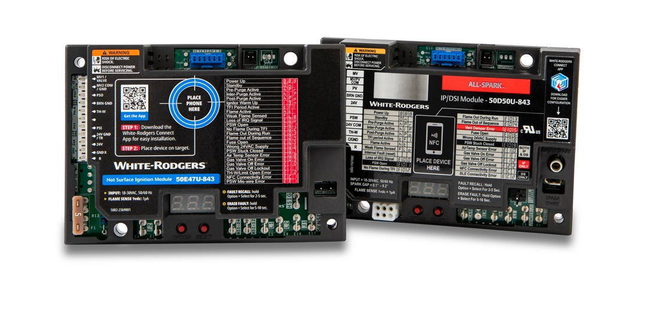
Universal Non-Integrated Ignition Modules
Simple configuration and diagnostics with White-Rodgers Connect
Hot Surface Ignition Module
50E47U-843
Replaces over 325 HSI part numbers that use 24V, 120V or 240V ignitors.
Controls an inducer motor and monitors a pressure switch.
Ignition Module Features
Transfer control wiring before removing the existing control with the easy-install harness.
Digital display provides alternate method to configure, diagnose and check real-time operation status & flame current (50E47U-843 only).
Use F67-8535 to maintain temperature without an external thermostat for infrared & tube heaters.
Applications
Pool heaters
Water heaters
Unit heaters
Gas furnaces
Boilers
Cooking equipment
Laundry equipment
Packaged Units
Infrared heaters
All-Spark Ignition Module
50D50U-843
Replaces over 1,000 part numbers for intermittent pilot & direct spark ignition.
Rajah & spade spark terminals on-board eliminate the need for an external adapter.

Slide 16
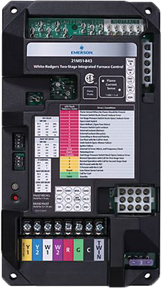
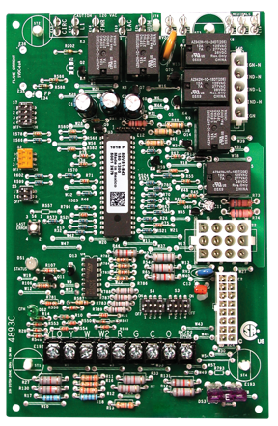
Universal Two-Stage Integrated Furnace Controls
Furnace Control for PSC Blower Motors
21M51U-843
Furnace Control for Variable Speed Motors
21V51U-843
Replaces 92 part numbers on two-stage HSI systems with PSC blower motors for 80 or 120V ignitors.
Includes universal HotRod ignitor and Trane mounting bracket for upgrading 80V systems.
Replaces 59 part numbers on two-stage variable speed systems with 80V or 120V ignitors.
Includes universal HotRod ignitor for upgrading 80V systems.
Provides proper signals to 5 different manufacturers ECMs.

Slide 17
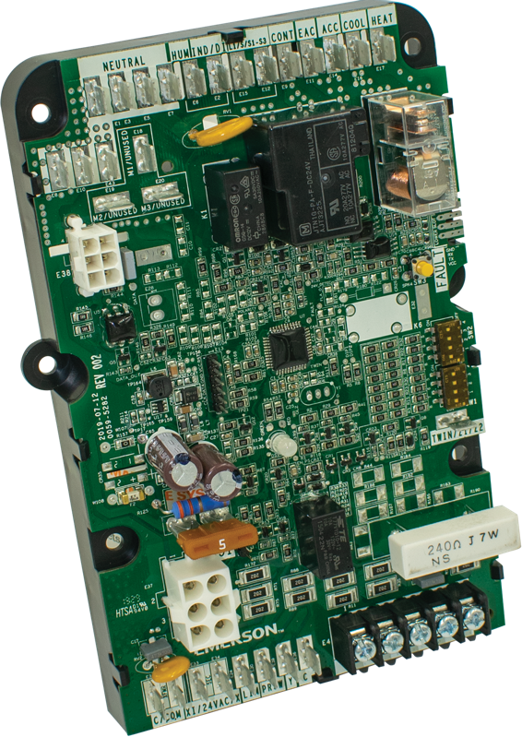
Universal Electronic Fan Timer
Non-Integrated Furnace Electronic Fan Timer
50F06-843
Replaces over 160 part numbers.
Integrates with direct spark ignition, hot surface ignition and intelligent ignition controls.
Easy wiring – harnesses with terminal flags and terminals labeled to match multiple existing boards boards.
Simple diagnostics with tri-color LED and push-button fault recall & clearing​​.

Slide 18
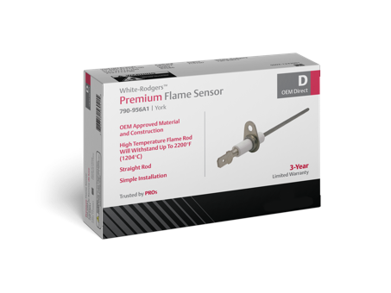
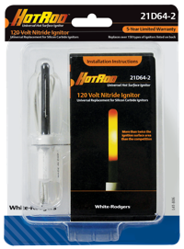
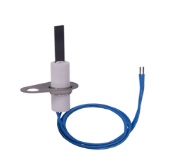
Universal Ignitors & Flame Sensors
Direct OEM drop-in replacements also available
Universal HotRod Ignitors 21D64-2, 21D64-44
Universal Flame Sensor 790-843A1
Replaces over 270 part numbers. ​
Includes mounting brackets & ceramic wire nuts.
Upgrade from silicon carbide for longer life & fewer callbacks.
5-year limited warranty.
Available in a 5-pack.
Bend and or cut to replace over 150 part numbers.
Protective sleeve included with detailed bend instructions.
High temperature rod withstands 2,200 ºF.
30” lead wire with ¼” & 3/16” quick connects.
3-year limited warranty.
Available in a 5-pack.
Spiral Design 21D64-2
Compact Flat Design 21D64-44

Slide 19
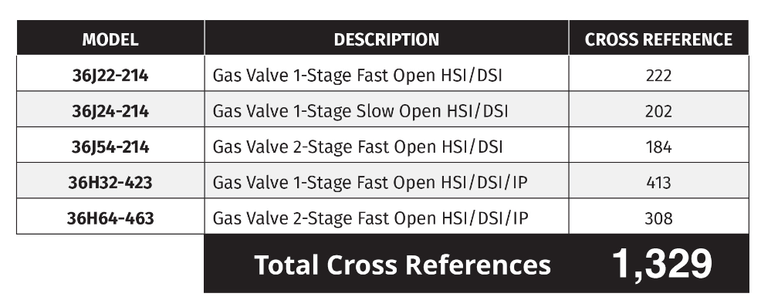
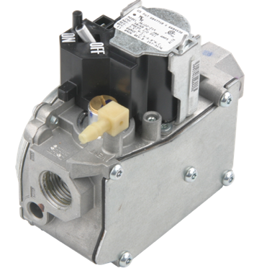
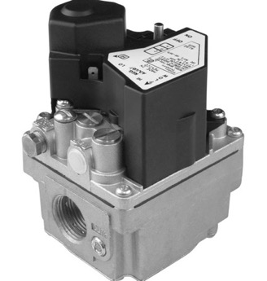
Our Gas Valves Are Trusted by More OEMs
Largest Manufacturer of gas values in North America
Easy installation
Truck Stock: Universal Gas Valves
Quick connect spade terminals
LP conversion kit (most models)
Reducer bushing kit (most models)
36G/J Series – Replaces 95% of residential furnaces made in the last 18 years.
36H Series – Designed for commercial HSI/DSI/IP systems.

Slide 20
Cooling & Heat Pump Controls

Slide 21
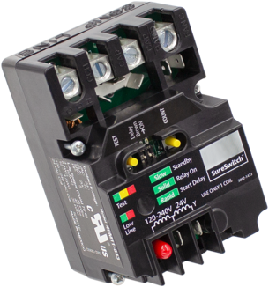
Universal Contactor & Defrost Control
SureSwitch Multi-Volt Contactor
49M11-843
Universal Heat Pump Defrost Control
47D01U-843
Replaces most single-phase contactors
Services air conditioning and refrigeration applications for 24/120/208/240V coils
5X the life of traditional contactors, 1M+ cycles
Totally sealed switch keeps out ants, pests and debris
5-year limited warranty
Replaces over 400 part numbers
Selectable demand or timed defrost modes for greater efficiency
Integrated thermostat provides energy and cost savings
Brownout and short cycle protection
1-year limited warranty

Slide 22
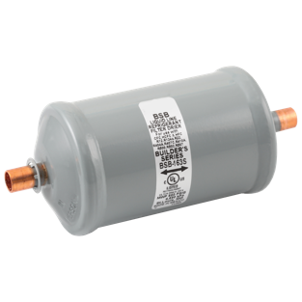
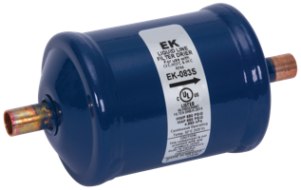
Universal Liquid Line Filter Driers
EK Series (Premium)
BSL Series (Economical)
BFK Series (Premium)
BSB Series (Economical)
20-micron filtration
Compacted bead construction
Solid copper connections for easy installation
Bi-directional for heat pumps
40-micron filtration
Solid core construction

Slide 23
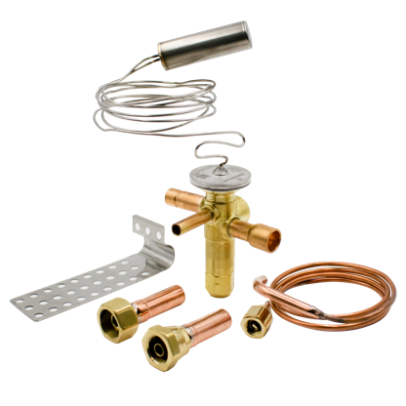
Universal Thermostatic Expansion Valve Kits
Residential AC & Heat pumps
TXV Connect Kits
ODF TXV with internal check, Chatleff & Aeroquip adapters, external equalizer connection and bulb strap
Universal kits that fit residential systems regardless of manufacturer
R-410A & R-22 kits in multiple capacities

Slide 24
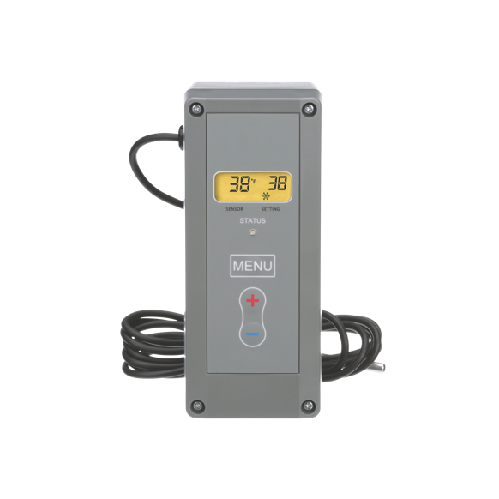
Universal Electronic Refrigeration Temperature Control
Replaces most mechanical and electronic refrigeration controls
16E09-101
Applications
Convenience store
Supermarket display case
Pump control
Freezer control
Boiler control
Walk-in cooler
Space and return-air temperature
Reach-in cooler
Condenser fan cycling
Multiple input voltages (24/120/208/240) with no common wire required on electrical loads greater than 2.5 amps
Adjustable anti-short cycle delay, set-point locking function
Alarm output with selectable delay up to 99 minutes

Slide 25
Thermostats

Slide 26
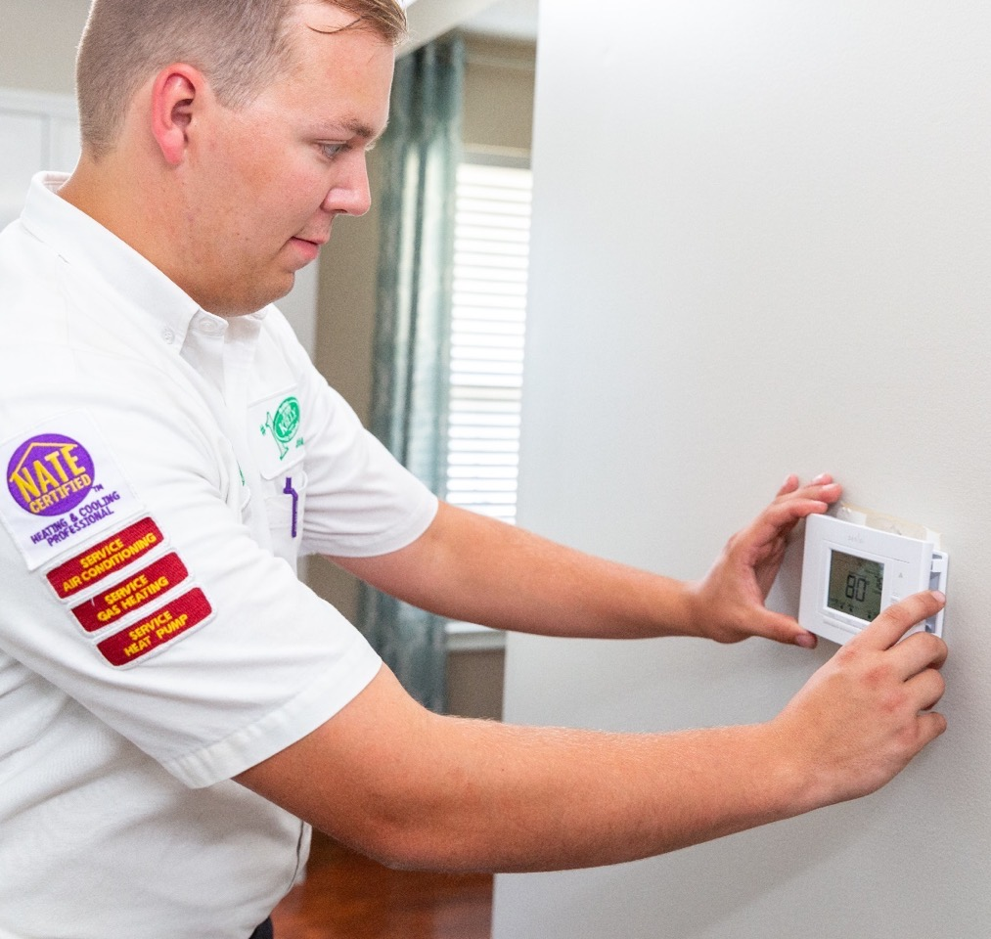
A Thermostat For Every Customer
Our White-Rodgers and Sensi Universal Thermostat SKUs replace an almost unlimited number of products.
Our thermostats are compatible with all major manufacturer systems and have the features customers want:
Touch screen
Wi-Fi compatible
Programmable/non-programmable
Various price points

Slide 27
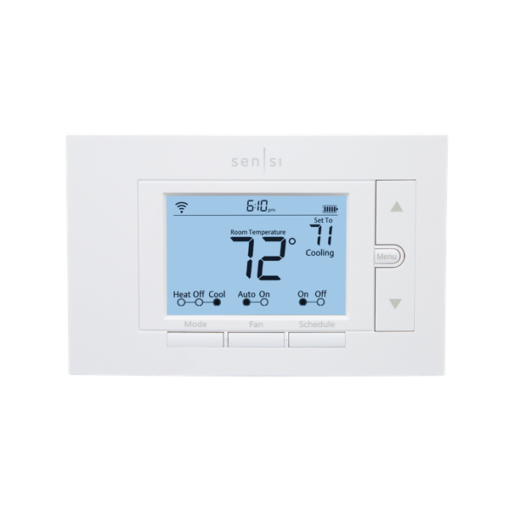
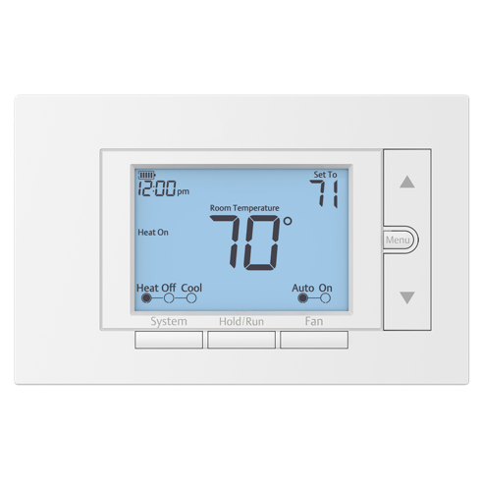
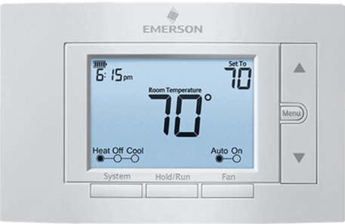
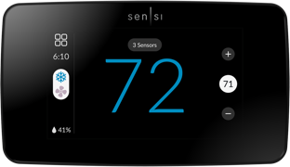
Universal Thermostats to fit almost any low voltage application
80 Series Thermostats
Sensi smart thermostat
1F87U-42WF
Sensi Touch 2 smart thermostat
1F96U-42WFB
Programmable & Non-Programmable options
Single stage/Multi-stage/Heat Pump
Wi-Fi compatible
Sensi app
Touch Screen
Remote sensors
Humidity control
Sensi app
Notes:
I don't think the four part numbers for the universal 80's and description adds value. Your two bullets cover the options offered.

Slide 28
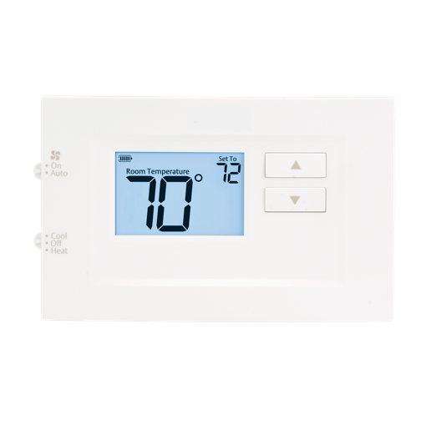
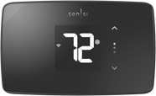
Thermostats for Multi-Family and New Construction
70 Series thermostats
Sensi Lite Smart Thermostat
1F76U-22WFB
Programmable & non-programmable options
Single Stage/ heat pump / PTAC
Economical Wi-Fi compatibility
5-year warranty
Notes:
Same story here with the 1F75 part numbers

Slide 29
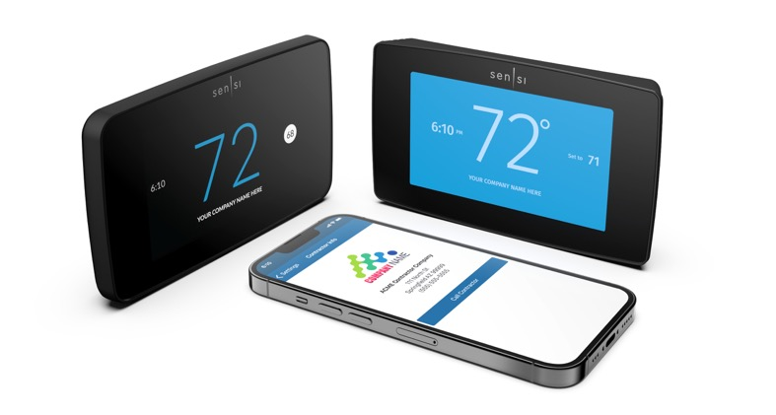
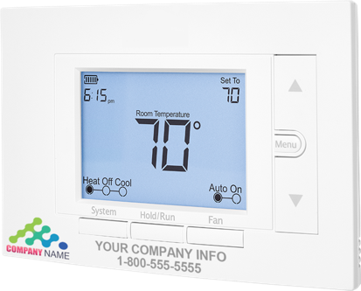
Stay Top of Mind with Free Contractor Branding
Printed Branding
Digital Branding
Create custom preview by adding full-color printed logo or custom text
Place order through your distributor for free with orders of 12 or more (excluding Sensi Lite & Touch 2)
With Sensi smart thermostats, add contractor’s information on the following locations:
Thermostat home screen (Touch 2)
Mobile app
Monthly usage report

Slide 30
s

Slide 31
Free Online Training
Install with confidence
Online NATE-certified training courses and webinars for ongoing education credits
Gain expertise on the latest products
View installation, technical and product modules for Thermostats, Heating, AC, Heat Pump & Refrigeration
Many of our top products include full length installation videos
Access Training Modules HERE

Slide 32
Contractor Rewards
Get rewarded for products your already buying
Easy. Rewarding. Free.
Contractors can sign up to participate in this free rewards program
Contractors upload invoices of participating products for points
Contractors redeem points for products or gifts

Slide 33
Thank you
R-5085-5. ©2024 Copeland LP. | The Copeland and White-Rodgers logos are trademarks and service marks of Copeland LP.

